Slide 1

Dynamic website for selling Fruits and Veggies online. “THE FRESH MARKET”
Mini project
Done by:
VIGNESH M
A22101PCA7501

Slide 2

Introduction:
Nowadays people are not ready get outside to buy something in their busy life. So here comes the dynamic website and easier, trending way of ordering online whatever and whenever needed.

Slide 3
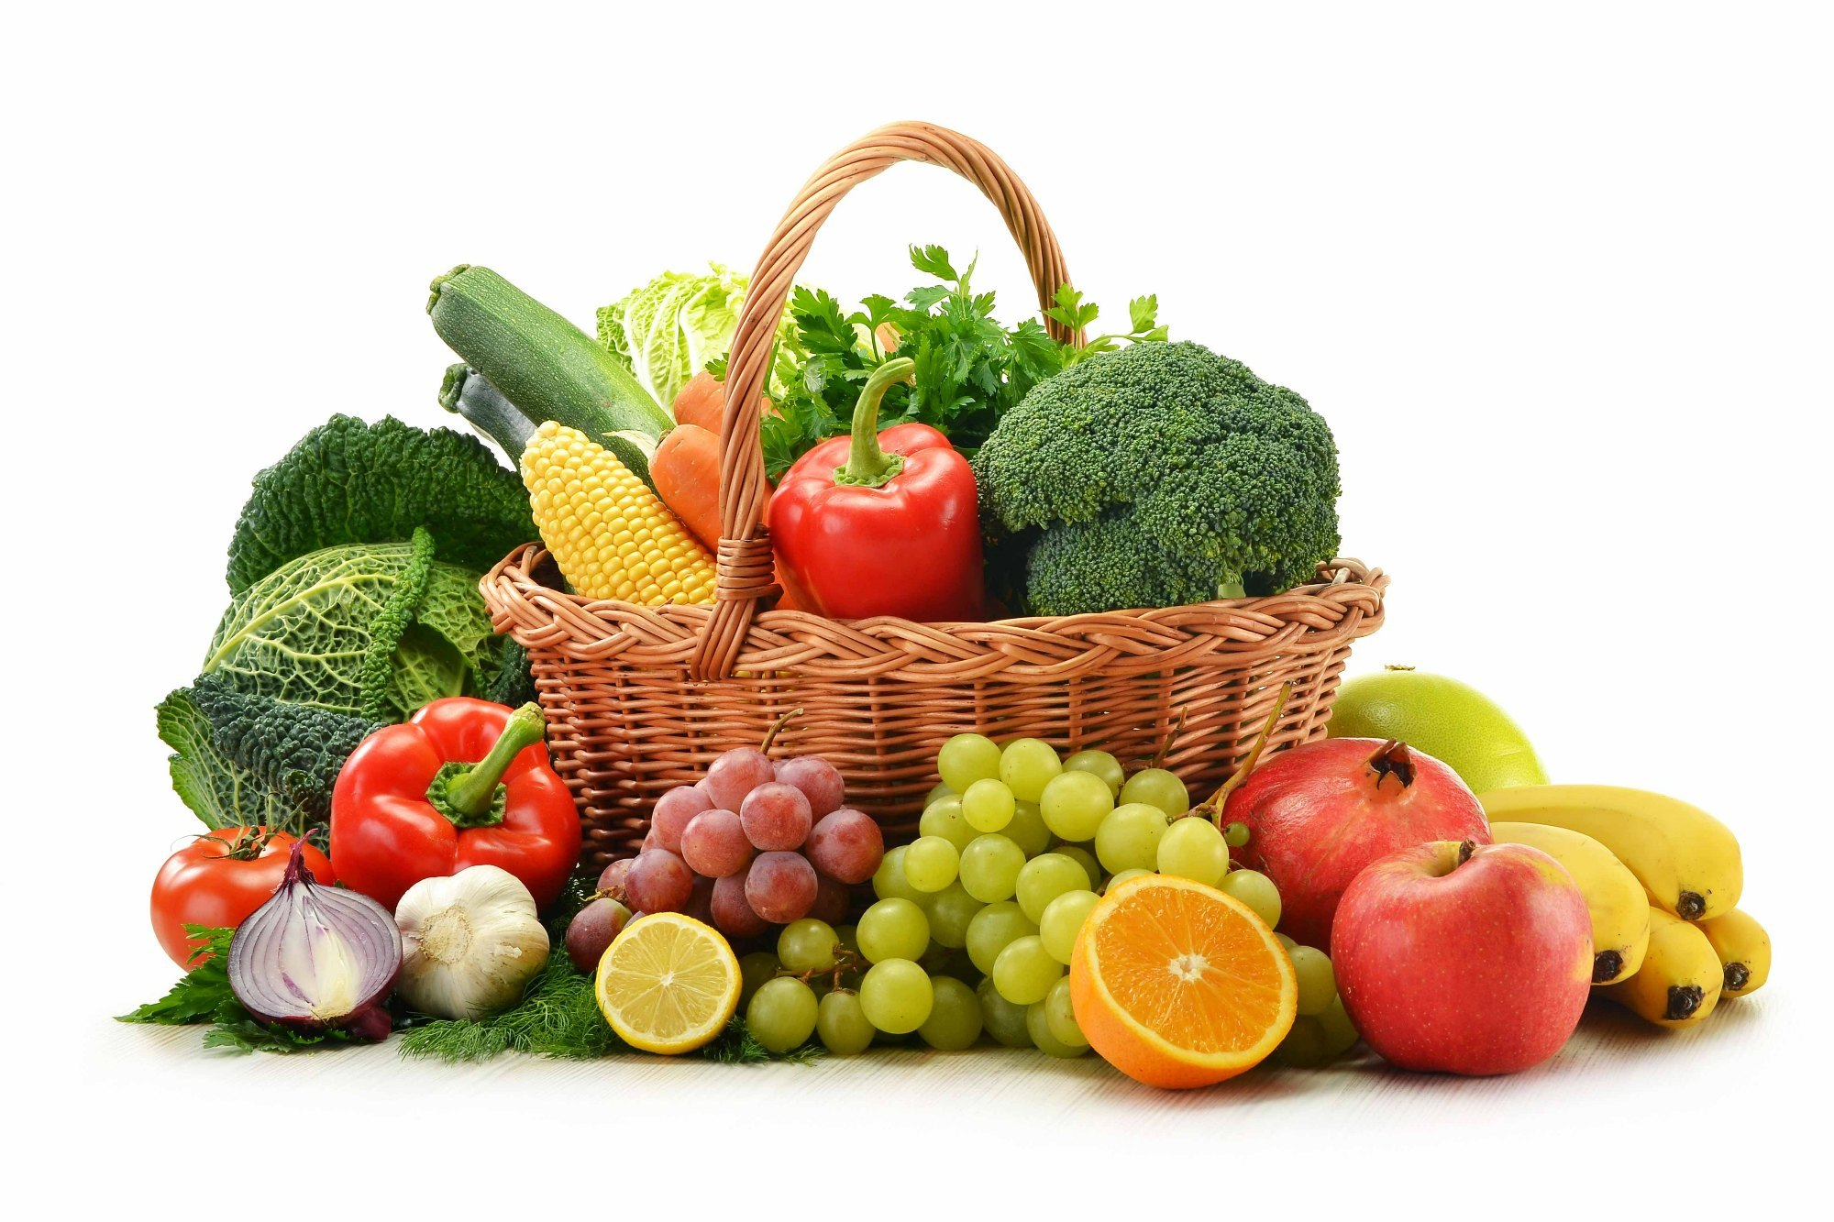
Objective:
The primary objective of the this dynamic website project is to provide a user-friendly online platform that offers convenient access to a diverse range of fresh fruits and vegetables.
To offer a seamless and efficient online ordering process, coupled with reliable delivery services, to enhance the overall convenience for customers.
To establish partnerships with local farmers to ensure a direct and sustainable supply chain, promoting the growth of local agricultural communities.

Slide 4
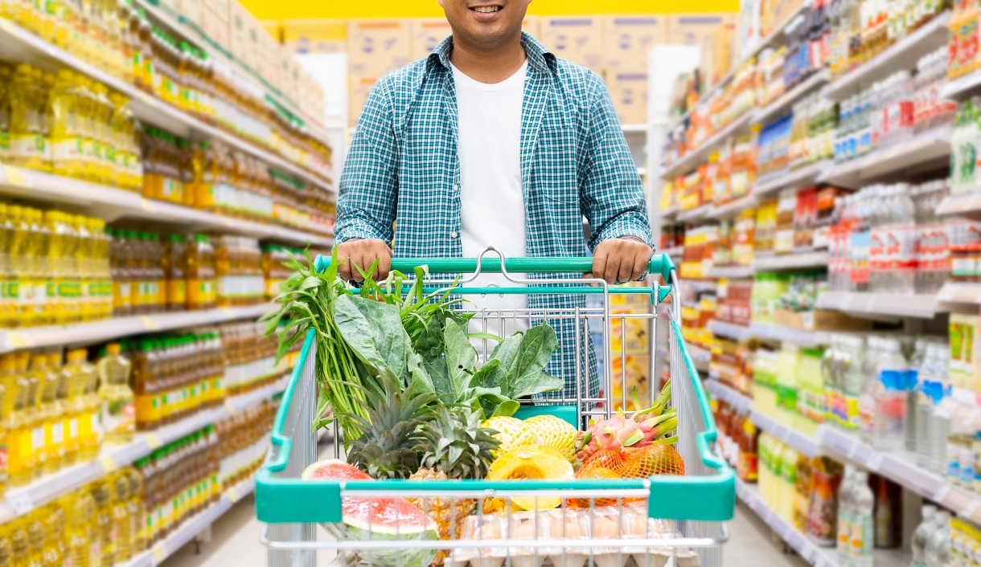
Existing system:
Traditional or manual methods of purchasing fruits and vegetables may involve physical visits to local markets, which can be time-consuming and may not offer the same convenience as an online platform.
Disadvantages:
Time-Consuming
Lack of Information
Dependency on Middlemen
Limited Variety
Inefficient Supply Chain

Slide 5

Produced system:
With the produced system, i.e.., the online selling website, it can redefine the way customers experience and access fresh fruits and vegetables, making it a more efficient, convenient, and enjoyable process
Advantages:
Convenience
24/7 Availability
Detailed Product Information
Efficient Supply Chain
Order Tracking and Delivery

Slide 6


Software requirements:
Front end:
HTML CSS
Back end:
PHP JS XAMPP server V3.3.0
IDE & OS
VS code Windows 7 or above

Slide 7
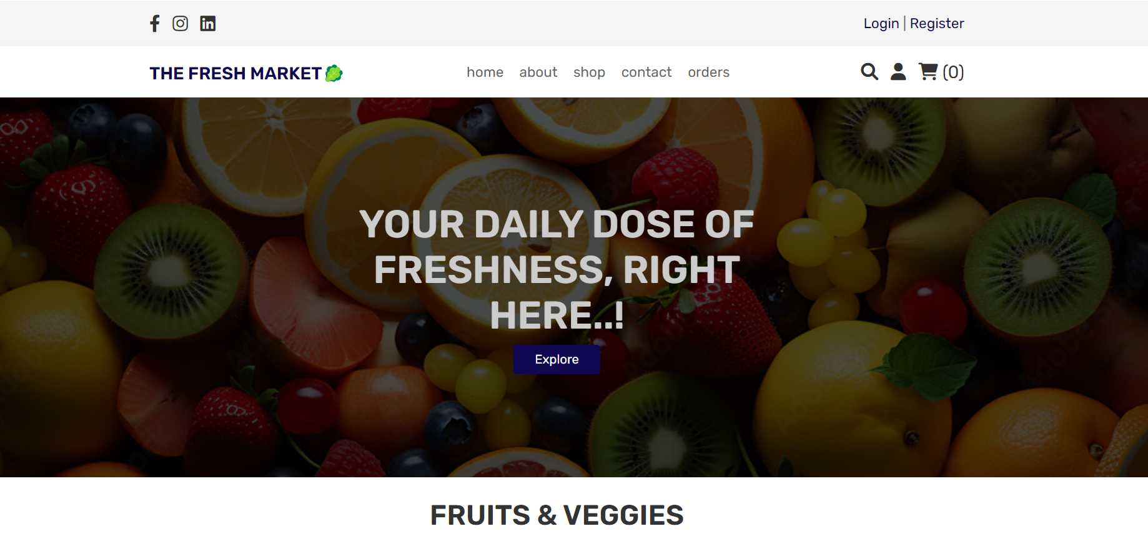
Module lists:
Registration Module
User Login Module
Admin Login Module
Home Module
About Module
Shop Module
Contact Module
orders Module

Slide 8
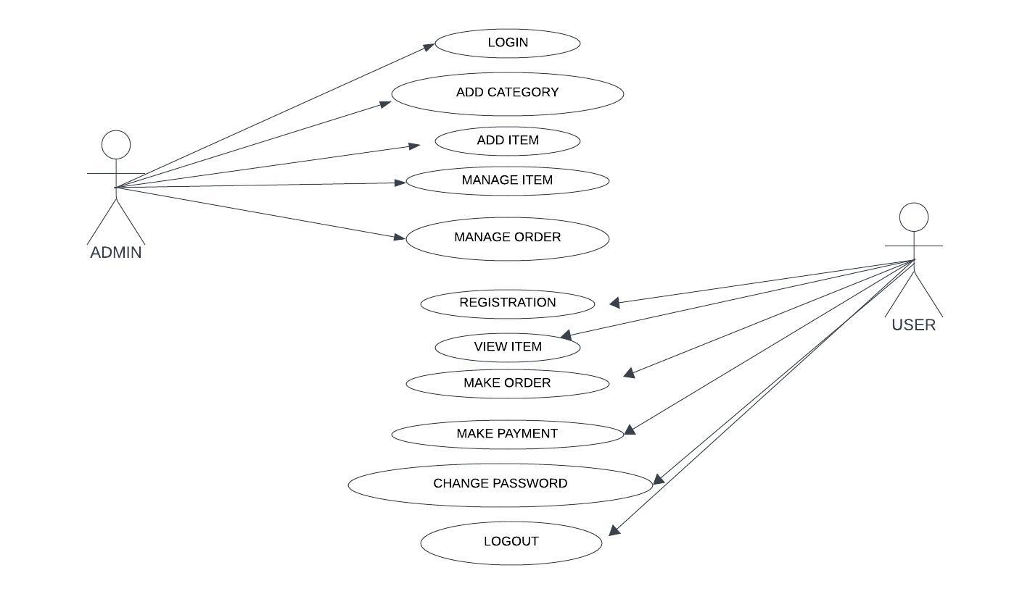
UML Diagram:

Slide 9
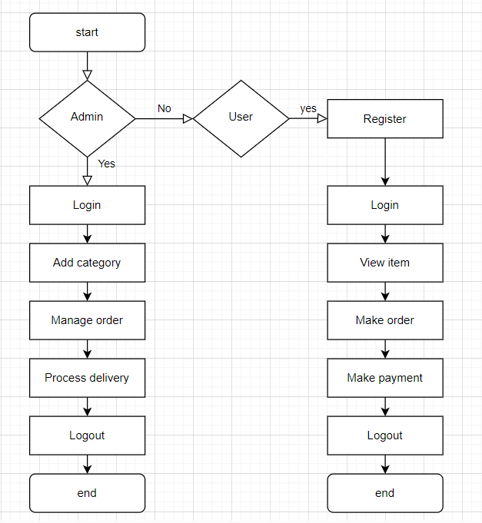
Workflow diagram:

Slide 10
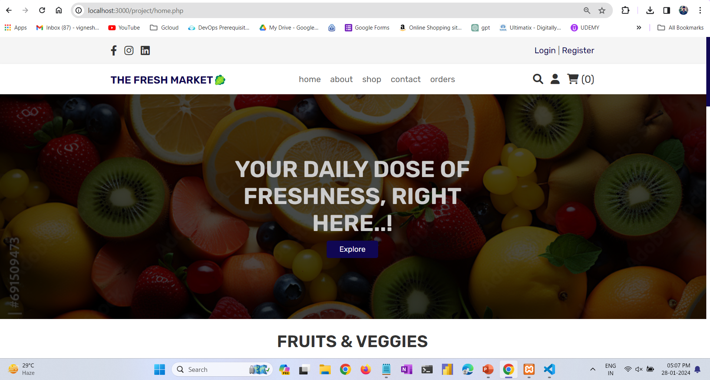
Home Page

Slide 11
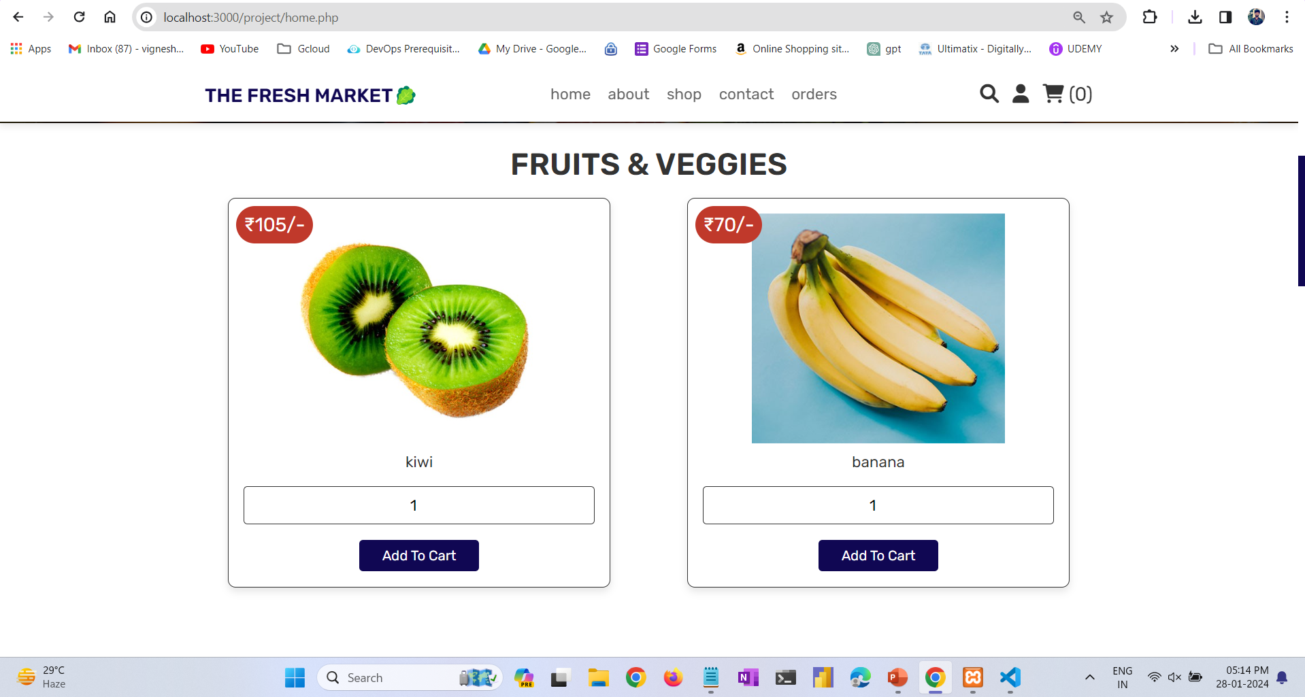
Items available

Slide 12
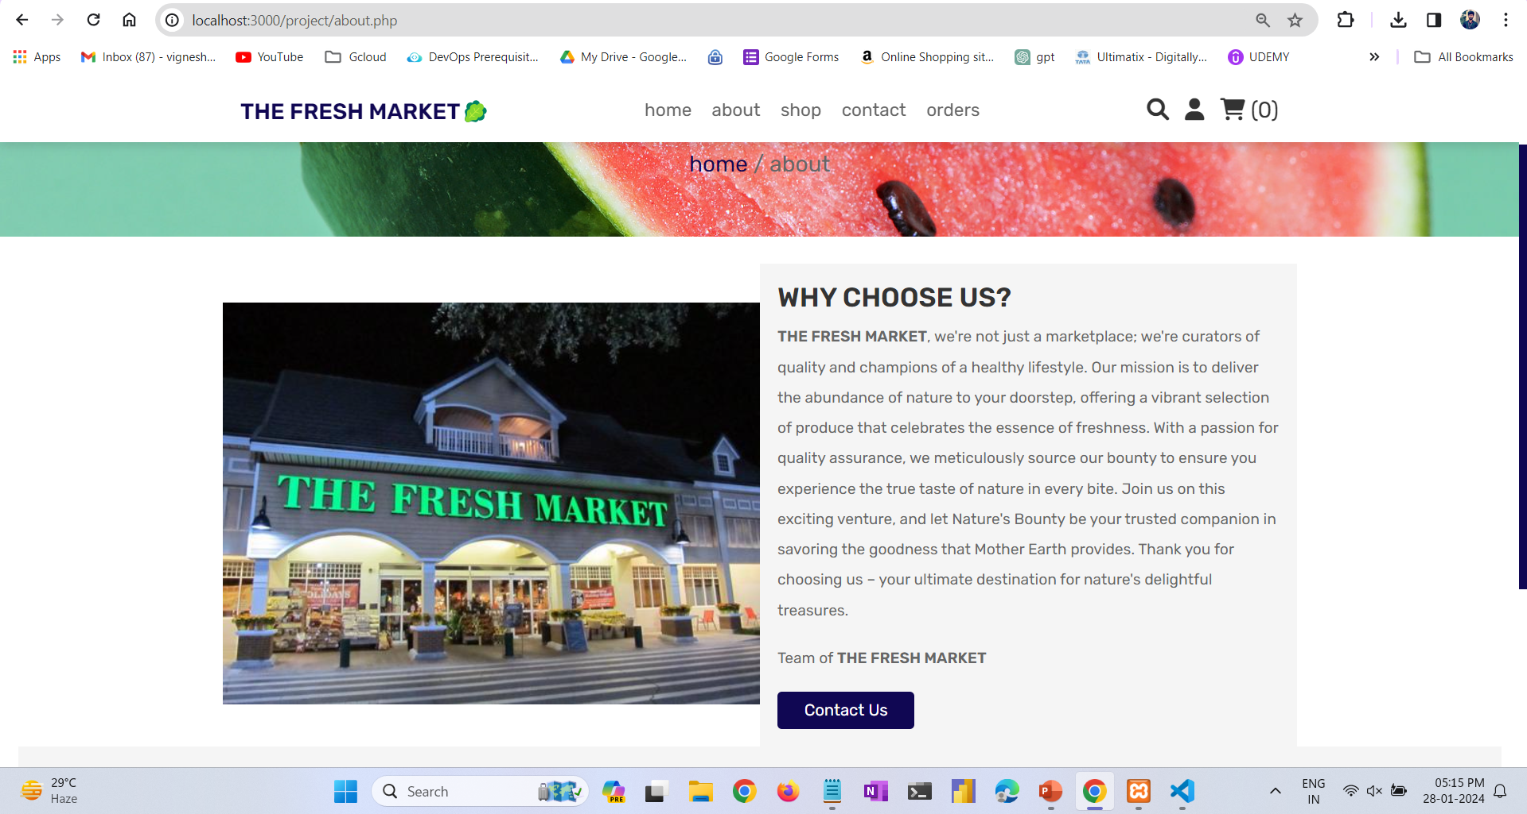
About page

Slide 13
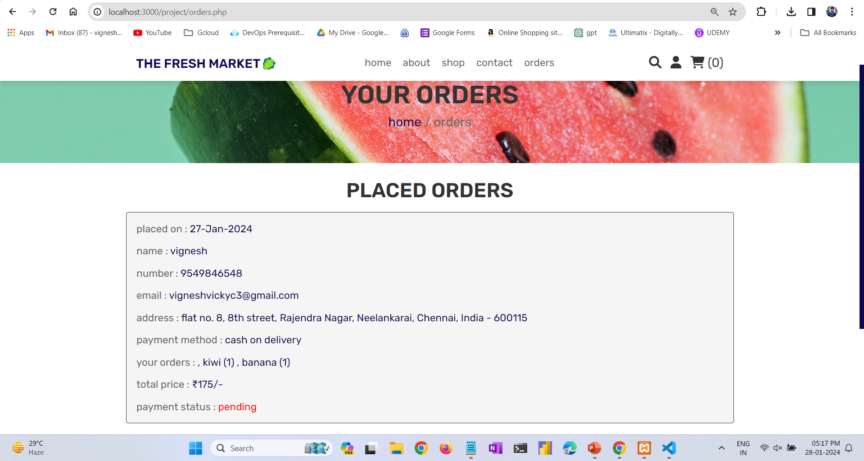
Order status

Slide 14
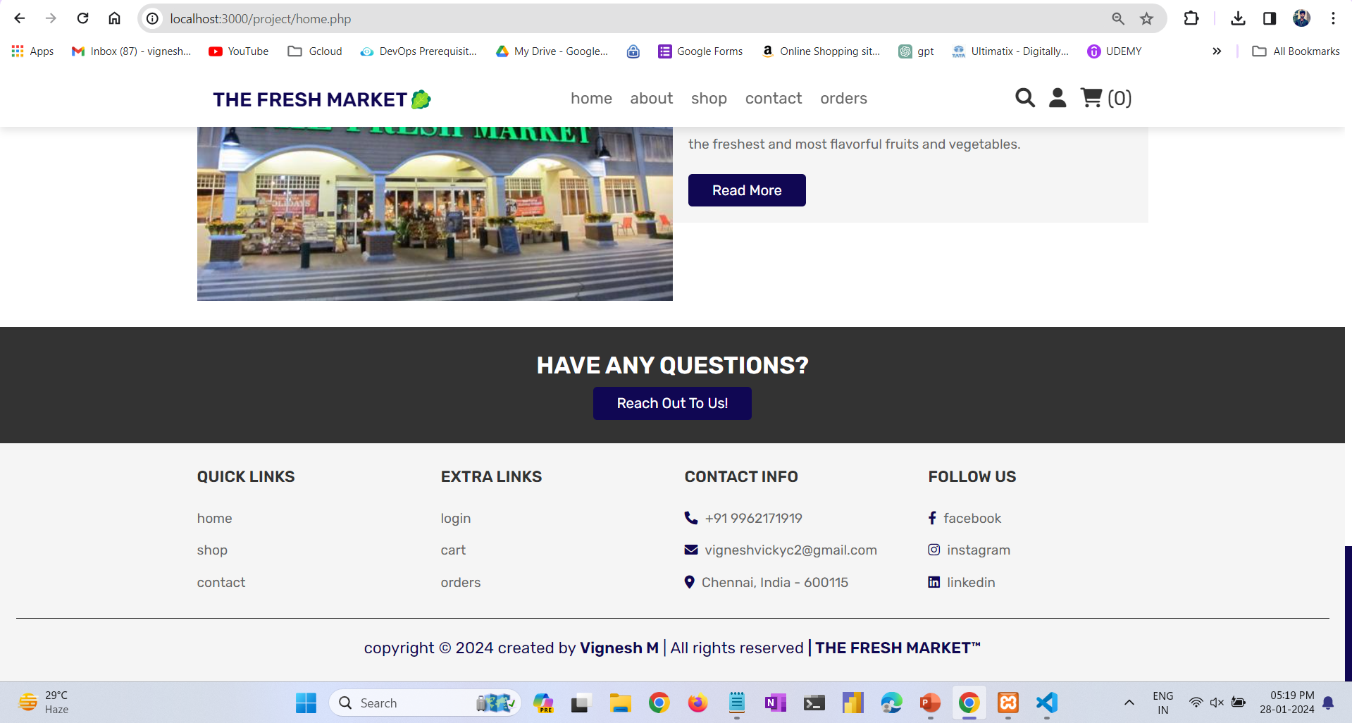
Footer:

Slide 15


Conclusion: This project has successfully revolutionized the way users experience online food shopping, providing a seamless and convenient platform for accessing fresh fruits and vegetables. The user-centric design, efficient order processing, and direct connections with local farmers will contribute positive and enjoyable shopping experience. Expected future enhancement: Geographical Expansion Mobile App Development

